Slide 1
Macroeconomics ECON 101
Fiscal Policy
(Chapter 12)
Instructor: Muhebullah Karimzada
Notes:
If this PowerPoint presentation contains mathematical equations, you may need to check that your computer has the following installed:
1) MathType Plugin
2) Math Player (free versions available)
3) NVDA Reader (free versions available)

Slide 2
Chapter Outline
12.1 What is Fiscal Policy?
12.2 The Effects of Fiscal Policy on Real GDP and the Price Level
12.4 Government Purchases and Tax Multipliers
12.5 The Limits of Fiscal Policy as a Stimulus
12.6 Deficits, Surpluses, and Federal Government Debt
12.7 The Effects of Fiscal Policy in the Long Run
Appendix A Closer Look at the Multiplier

Slide 3
What is Fiscal Policy
12.1 Learning Objective
Define fiscal policy.
Fiscal policy refers to changes in federal taxes and purchases that are intended to achieve macroeconomic policy objectives.
(Provincial and territorial taxes and spending are not generally aimed at affecting national-level objectives.)
Some forms of government spending and taxes automatically increase or decrease along with the business cycle; these are automatic stabilizers.
Example: Employment insurance payments are larger during a recession.
Discretionary fiscal policy, on the other hand, refers to intentional actions the government takes to change spending or taxes.

Slide 4
The Effects of Fiscal Policy on Real GDP and the Price Level
12.2 Learning Objective
Explain how fiscal policy affects aggregate demand and how the government can use fiscal policy to stabilize the economy.
The government carry out fiscal policy through:
Changes in government purchases
Changes in taxes
A change in government purchases directly affects aggregate demand.
A change in taxes changes income; this in turn affects consumption, and so it has an indirect effect on aggregate demand.

Slide 5
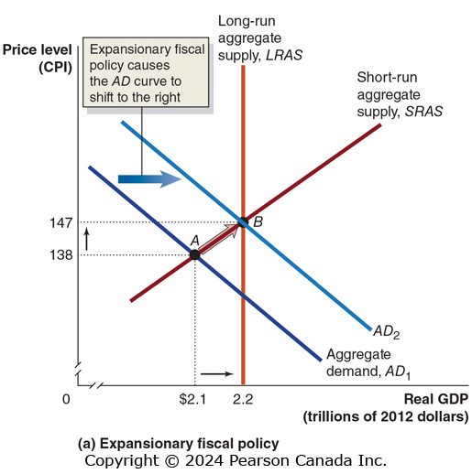
Figure 12.7 Fiscal Policy (1 of 2)
Expansionary fiscal policy involves increasing government purchases or decreasing taxes.
Increasing government purchases directly increases aggregate demand.
Decreasing taxes indirectly affects aggregate demand by increasing disposable income, and hence consumption spending.
If the government believes real GDP will be below potential GDP, it can enact expansionary fiscal policy in an attempt to restore long-run equilibrium—decreasing unemployment.

Slide 6
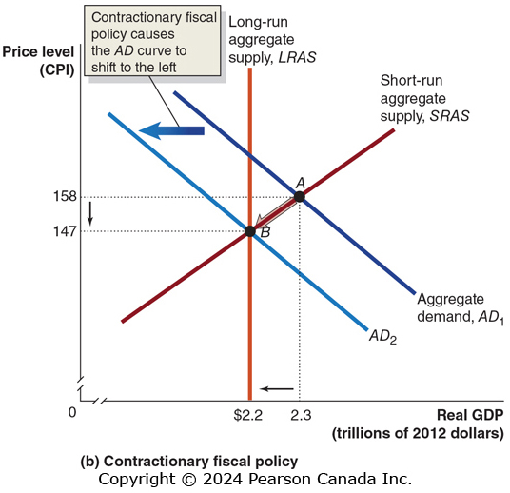
Figure 12.7 Fiscal Policy (2 of 2)
Contractionary fiscal policy involves decreasing government purchases or increasing taxes.
This works just like expansionary fiscal policy, only in reverse.
If the government believes real GDP will be above potential GDP, it can enact contractionary fiscal policy in an attempt to restore long-run equilibrium—decreasing inflation.

Slide 7
Table 12.1 Countercyclical Fiscal Policy
Problem | Type of Policy Required | Actions by Congress and the President | Result
Recession | Expansionary | Increase government purchases or cut taxes | Real G D P and the price level rise.
Rising inflation | Contractionary | Decrease government purchases or raise taxes | Real G D P and the price level fall.
Bear in mind that:
The effects described assume ceteris paribus: everything else is staying the same, including monetary policy.
Contractionary fiscal policy is not really causing prices to fall; it’s causing inflation to be lower than it otherwise would have been.

Slide 8
The Government Purchases and Tax Multipliers
12.4 Learning Objective
Explain how the government purchases and tax multipliers work.
If the government increases its spending on goods and services, then aggregate demand increases immediately. This is the autonomous increase in aggregate demand.
But then people receive this increased spending as increased income, increasing their consumption spending accordingly. This is the induced increase in aggregate demand.
The series of induced increases in consumption spending that results from the initial increase in autonomous expenditures is known as the multiplier effect.

Slide 9
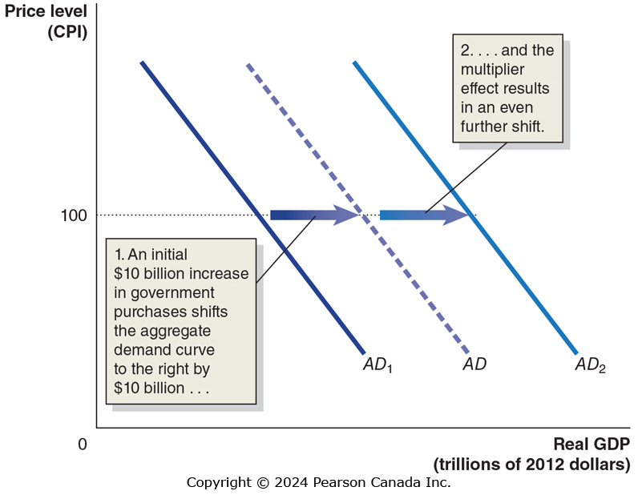
Figure 12.10 The Multiplier Effect and Aggregate Demand
Predicting the eventual (multiplied) effect of a change in autonomous expenditures requires knowing how big the multiplier is.

Slide 10
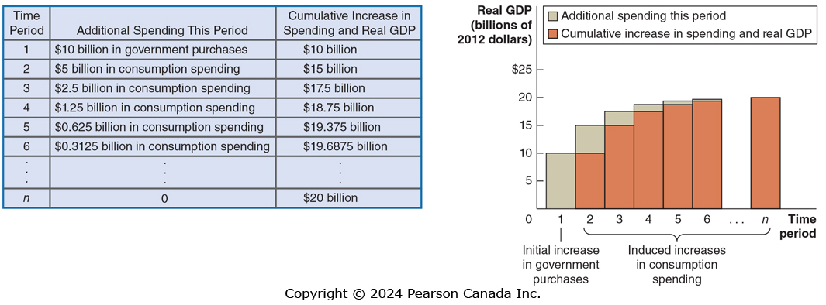
Figure 12.11 The Multiplier Effect of an Increase in Government Purchases
Suppose each increase in spending induces an increase in consumption spending by one-half of the increase in income from the previous period, on domestically produced goods and services.
Over time, a $10 billion increase in government purchases will result in an additional $10 billion in induced consumption spending.

Slide 11
Multipliers for Government Purchases and Taxes
We can describe the total effect of a change (increase or decrease) in government purchases or taxes by measuring the change in equilibrium real GDP.
The tax multiplier will be a negative number: an increase in taxes will decrease equilibrium real GDP, and vice versa.
We expect the tax multiplier to be smaller (in absolute value) than the government purchases multiplier.
Why? A $10 billion increase in purchases initially increases spending by $10 billion, but a $10 billion tax cut is partially spent and partially saved.

Slide 12
The Effect of Changes in Tax Rates
The tax multiplier applies to changes in the amount of taxes, without changes in tax rates.
Decreases in tax rates have a slightly different effect:
Increasing the disposable income of households, leading them to increase their consumption spending.
Increasing the size of the multiplier effect, since more of any increase in income becomes disposable income.

Slide 13
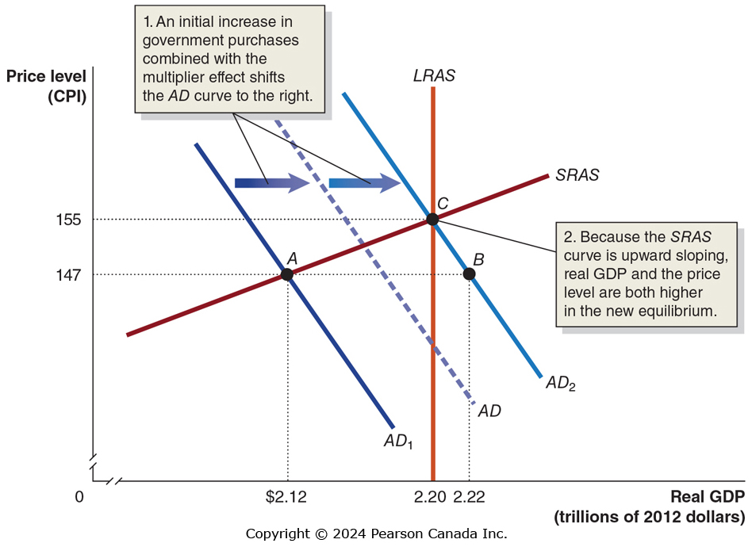
Figure 12.12 The Multiplier Effect and Aggregate Supply
An increase in aggregate demand will not only result in real GDP rising; it will also result in a price level increase, because the short-run aggregate supply (SRAS) curve is upward-sloping.
Suppose that between the autonomous and induced effects, fiscal policy causes aggregate demand to increase by $100 billion.
The resulting real GDP increase is smaller—only $100 billion (from $2.12 trillion to $2.22 trillion). The price level also rises.

Slide 14
The Multipliers Work in Both Directions
An increase in government purchases and a cut in taxes have a positive multiplier effect.
A decrease in government purchases and an increase in taxes have a negative multiplier effect.
Example: a reduction in government spending on infrastructure initially affects contractors, but then it would spread to suppliers and employees of those contractors, and then to other firms and workers.

Slide 15
The Limits of Fiscal Policy as a Stimulus
12.5 Learning Objective
Discuss the difficulties that can arise in implementing fiscal policy.
For several reasons, fiscal policy may be even less effective than monetary policy at countercyclical stabilization:
Timing of fiscal policy is harder, due to:
Legislative delay: Parliament needs to agree on the actions
Implementation delay: Large spending projects may take months or even years to begin, even after approval.
Government spending might crowd out private investment.
Crowding out: A decline in private expenditures as a result of an increase in government purchases

Slide 16
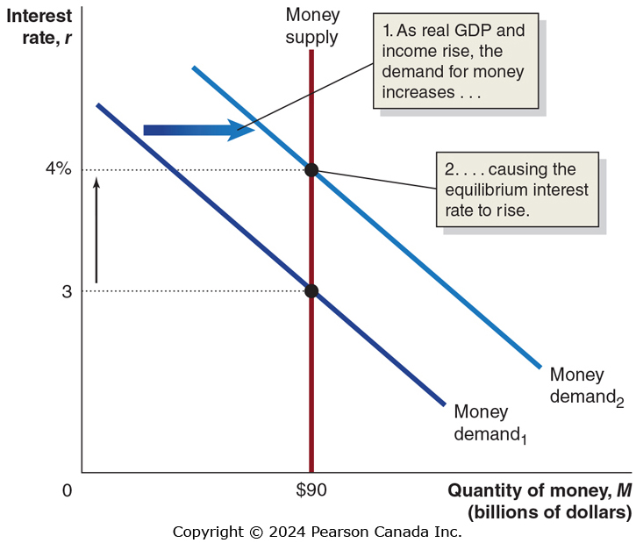
Figure 12.13 An Expansionary Fiscal Policy Increases Interest Rates
A temporary increase in government purchases will cause the demand for money, and hence the interest rate, to rise.
But with the higher interest rate, consumption, investment, and net exports all fall.

Slide 17
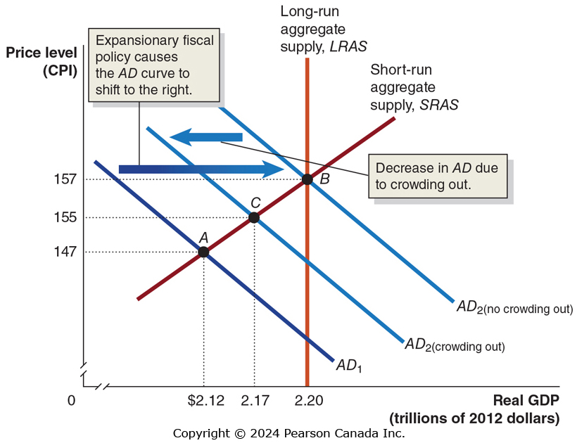
Figure 12.14 The Effect of Crowding Out in the Short Run
A temporary increase in government purchases will cause the demand for money, and hence the interest rate, to rise.
With the higher interest rate, consumption, investment, and net exports all fall.
So the initial increase in spending…
… is partially offset because of crowding out.

Slide 18
Crowding Out in the Long Run
In the long run, the increase in government purchases will have no effect on real GDP; the reduction in consumption, investment, and net exports will exactly offset the increase in government purchases.
Why? Because in the long run, the economy returns to potential GDP, even without the government’s intervention.

Slide 19
Deficits, Surpluses, and Federal Government Debt
12.6 Learning Objective
Define federal budget deficit and federal government debt, and explain how the federal budget can serve as an automatic stabilizer.
A budget deficit is the situation in which the government’s expenditures are greater than its tax revenue.
A budget surplus is the situation in which the government’s expenditures are less than its tax revenue.
Do you know whether the federal government is running a budget deficit or a budget surplus currently?

Slide 20
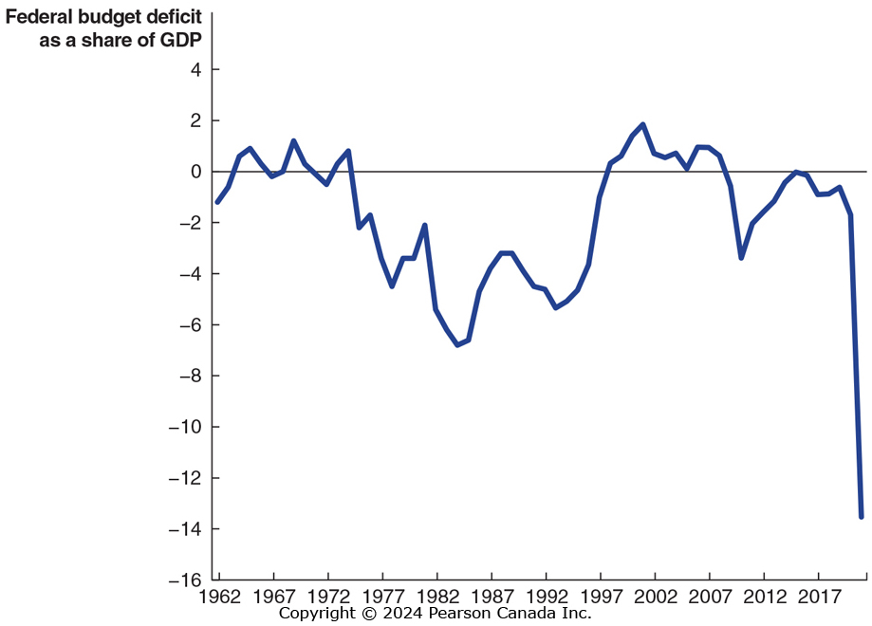
Figure 12.15 The Federal Budget Deficit, 1962–2021
The federal government has run deficits for most years since 1962.
Deficits are larger during recession than expansions, but not always.
Typical during recessions, as tax receipts fall, and automatic stabilizers, like increases in transfer payments (unemployment insurance, welfare, etc.), take effect.
These automatic stabilizers are important for limiting the severity of a recession; many economists believe that the Great Depression of the 1930s was more severe because most of these automatic stabilizers did not exist then.
SOURCE: Government of Canada, Department of Finance, “Fiscal Reference Tables for 2021,” https://www.canada.ca/en/department-finance/services/publications/fiscal-reference-tables/2021.html, and for 1996, https://www.canada.ca/content/dam/fin/migration/frt-trf/pdf/frt96e.pdf.

Slide 21
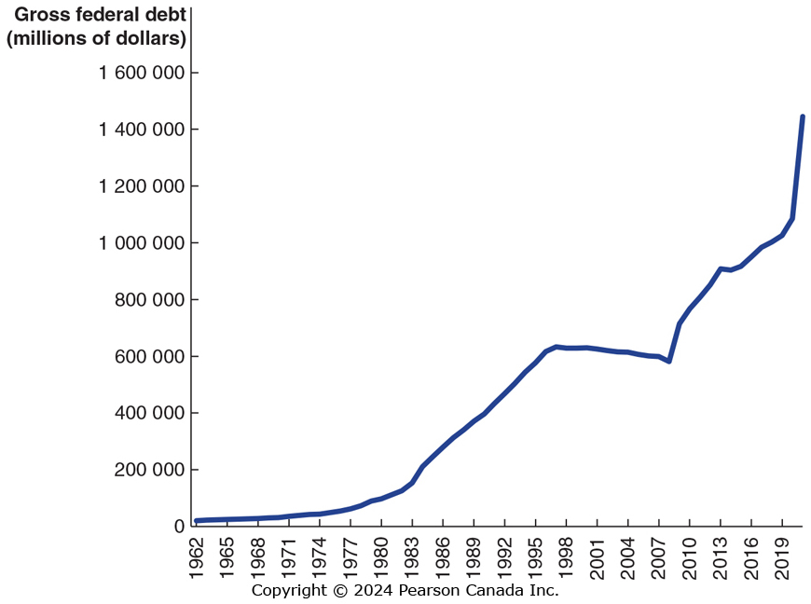
Figure 12.16 The Federal Government Debt, 1962–2021
When the federal government runs a budget deficit, it finances its activities by selling securities (bonds).
The total value of those securities outstanding is known as the federal government debt, or the national debt.
With the exception of 2000 to 2008, Canada’s debt has been growing the entire period of time.
The debt stabilized again in 2013–2014 but began rising in 2015. In 2020 to 2022, the federal debt rose dramatically as government revenue initially fell and expenditures rose rapidly.
SOURCE: Government of Canada, Department of Finance, “Fiscal Reference Table for 2021,” https://www.canada.ca/en/department-finance/services/publications/fiscal-reference-tables/2021.html, and for 1996, https://www.canada.ca/content/dam/fin/migration/frt-trf/pdf/frt96e.pdf.

Slide 22
Is Government Debt a Problem?
For now, the federal government is at no serious risk of defaulting on its debt, because:
The interest rate it can borrow money at is very low, and
The size of the interest payments on the debt is low relative to the size of the federal budget
In the long run, a debt that increases in size relative to GDP can pose a problem—potentially crowding out investment, which is a key component of long term growth.
This problem is reduced if the government debt was incurred to finance infrastructure, education, or research and development; these serve as a long term investment for the economy.

Slide 23
The Effects of Fiscal Policy in the Long Run
12.7 Learning Objective
Discuss the effects of fiscal policy in the long run.
The fiscal policy we have concentrated on so far was intended to address short-run goals of stabilizing the economy.
But other fiscal policy actions are intended to have long-run impacts on potential GDP—i.e. on aggregate supply, rather than aggregate demand.
Hence these actions are often referred to as supply-side economics.
Most of these policies are based on changing taxes in order to increase incentives to work, save, invest, and start a business.

Slide 24
The Long-Run Effects of Tax Policy
Most taxes are assessed as a percentage of some economic activity, like individual income, corporate income, or capital gains.
When an individual decides how much to work, he bases the decision on how much an hour of work will increase his ability to consume goods and services—the post-tax wage.
When a firm decides how many people to employ, it considers how much it has to pay in total for each worker: the pre-tax wage.
The difference between the pretax and post-tax return to an economic activity is known as the tax wedge. It applies to the marginal tax rate which is the fraction of each additional dollar of income paid in taxes.
A large tax wedge distorts the incentives of individuals and firms to take part in economic activities, generally resulting in lower levels of economic activity—lower real GDP.

Slide 25
Tax Rates Matter
Tax rates matter because the larger they are, the larger will be the behavioral response to the tax:
Individual income tax
Affects labour supply decisions and the returns to entrepreneurship
Corporate income tax
Affects the incentives of firms to engage in investment
Tax on dividends and capital gains
Affects the supply of loanable funds from households to firms, and hence the real interest rate.
Also affects the way firms disburse profits.

Slide 26
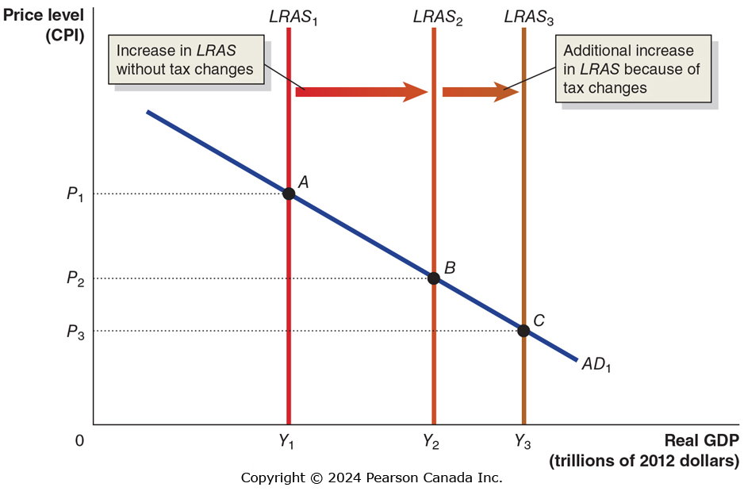
Figure 12.17 The Supply-Side Effects of a Tax Change
Tax reform has the potential to increase real GDP in the long run beyond the increases that would occur without tax changes.
The magnitude of the effect is uncertain, however.
For example, while people might like to work more if tax rates are lowered, they might be constrained by employers expecting a particular work week (like 40 hours). Economists believe that more study is needed on the impact of tax reforms.

Slide 27
Appendix A Closer Look at the Multiplier Formula
Learning Objective
Apply the multiplier formula.
Our objective in this appendix is to develop an econometric model for how real GDP is determined.
Then we will use that model to identify:
The government purchases and tax multipliers
How those multipliers are altered by tax rates
How those multipliers change in an open economy, i.e. when net exports change in response to income changes.
Throughout, we will assume that price level is constant.

Slide 28
An Expression for Equilibrium Real GDP (1 of 2)
For simplicity, we will initially assume that taxes do not depend on income (i.e. they are a fixed amount), there are no government transfers to households, and there are no imports or exports.
1. C = 1,000 + 0.8(Y − T) | Consumption function
2. I = 125 | Planned investment function
3. G = 125 | Government purchases function
4. T = 100 | Tax function
5. Y = C + I + G | Equilibrium condition
These numbers are in billions of dollars, except the marginal propensity to consume (MPC) of 0.8.
Consumption depends on disposable income Y – T.
Then we can write:
Y = 100 + 0.8(Y − 100) + 125 + 125

Slide 29
An Expression for Equilibrium Real GDP (2 of 2)
Subtracting 0.8Y from both sides, we obtain:
Thus we conclude that according to our model, real GDP will be $13 trillion.

Slide 30
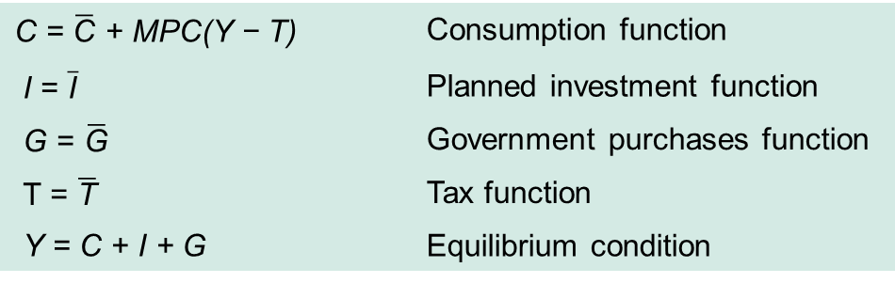
An Algebraic Expression for Equilibrium Real GDP
Instead of inserting numbers, we could find an expression for real GDP algebraically. Let:
C = $\overline{\text{C}}$ + MPC(Y − T) | Consumption function
I = $\overline{\text{I}}$ | Planned investment function
G = $\overline{\text{G}}$ | Government purchases function
T = $\overline{\text{T}}$ | Tax function
Y = C + I + G | Equilibrium condition
(The letters with bars represent fixed or autonomous variables.)
Then:

Slide 31
A Formula for the Government Purchases Multiplier
Any change in an autonomous variable will change the value of real GDP (Y). We can make that explicit by writing the variables in change form:
This uses the standard notation of ∆ for “change”.
Keeping autonomous consumption (C), taxes (T), and investment (I) constant, we get:
Divide both sides by ∆G to obtain the government purchases multiplier:
For example, if MPC = 0.8, the government purchases multiplier will be:

Slide 32
A Formula for the Tax Multiplier
Any change in an autonomous variable will change the value of real GDP (Y). We can make that explicit by writing the variables in change form:
Now we will keep autonomous consumption (C), investment (I), and government purchases (G) constant:
Divide both sides by ∆T to obtain the tax multiplier:
For example, if MPC = 0.8, the tax multiplier will be:
A $10 billion increase in taxes decreases real GDP by $40 billion.

Slide 33
The “Balanced Budget” Multiplier
Suppose we increase government spending and taxes both by $10 billion. What would happen to real GDP?
Adding these effects and factoring out the $10 billion gives:
We can simplify this to:
So the balanced budget multiplier is 1: equal dollar increases in government spending and taxes lead to the same dollar increase in real GDP in the short run.

